Slide 1
Test Plan

Slide 2
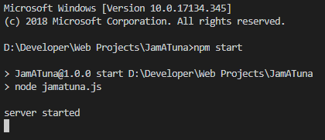
Run Server
Run the following commands in the project directory
npm install
npm start

Slide 3
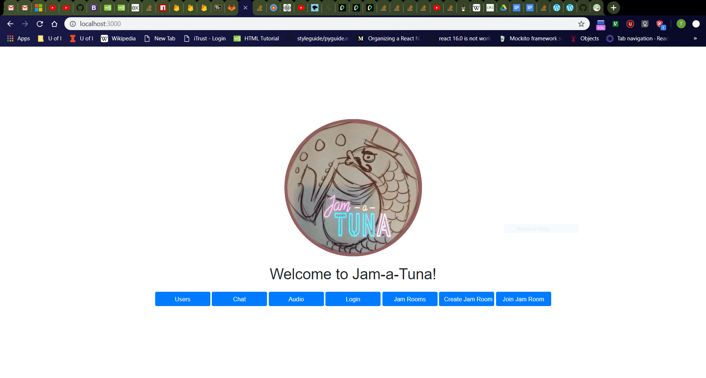
Home Page
Navigate to http://localhost:3000/
Should see Jam-a-Tuna image, text, and buttons
All buttons should work by taking you to a new page
Page should be centered in middle of browser

Slide 4
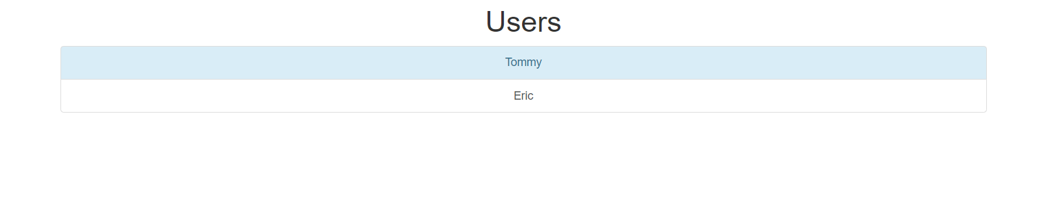
Users Page
Click “Users” button on home page.
Should navigate to http://localhost:3000/html/users.html
Should see list of users
Each user should be clickable
Odd-numbered entries should have a light-blue background.

Slide 5
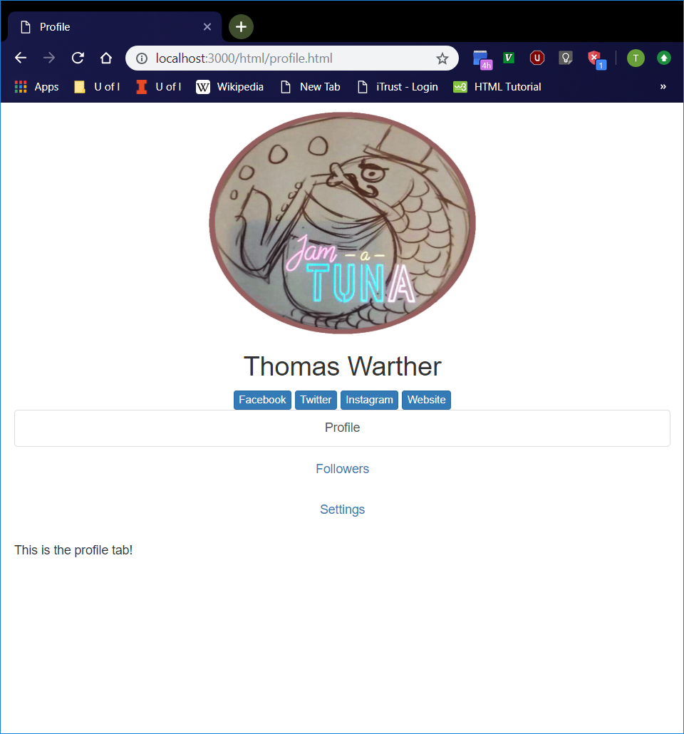
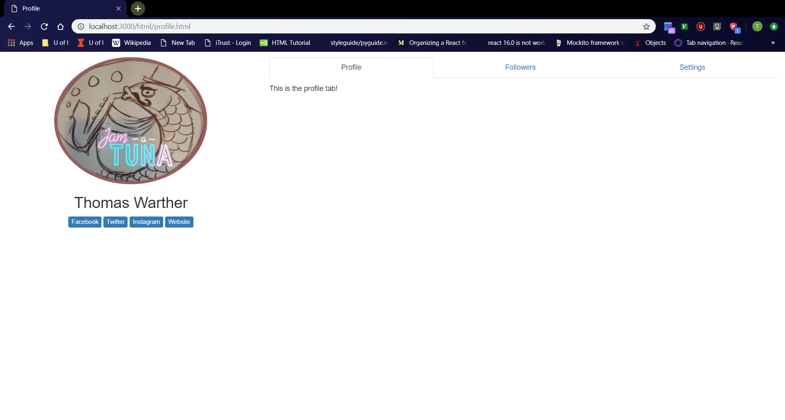
Profile Page
Vertical Window
Click “Tommy” entry on “Users” page.
Should navigate to http://localhost:3000/html/profile.html
Should see profile page with “Profile”, “Followers”, and “Settings” tabs
Tabs should be clickable
Profile page should adjust layout depending on screen orientation.
Full-Sized Window

Slide 6
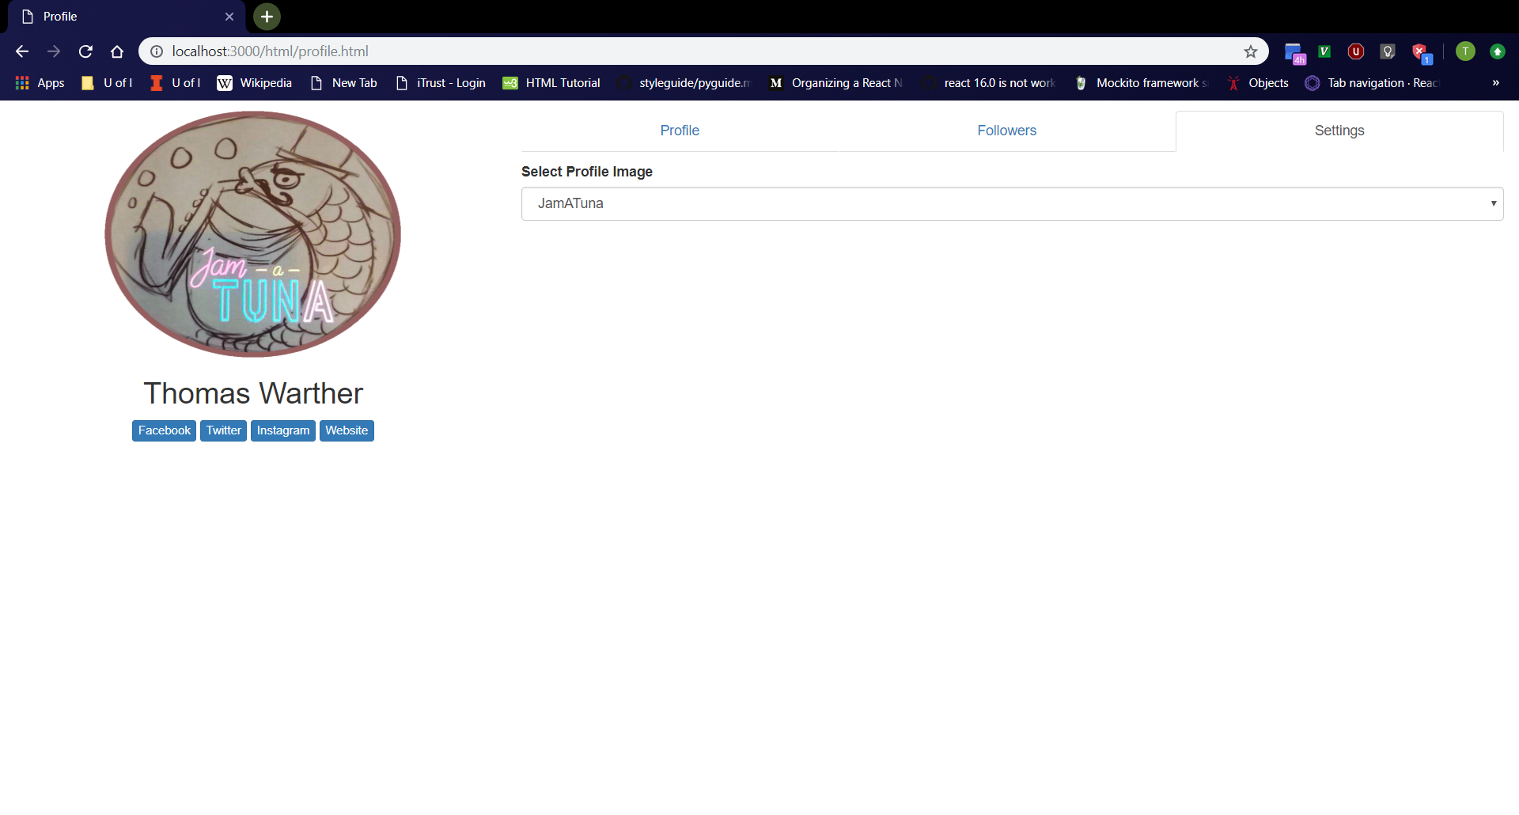
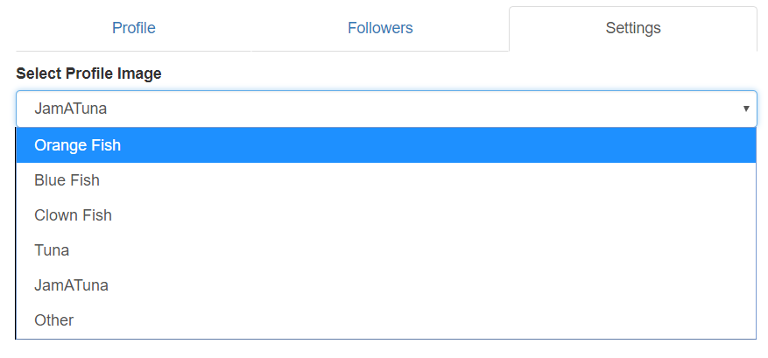
Settings Tab
Settings Tab
Click “Settings” tab on “Profile” page.
Should see dropdown menu with label “Select Profile Image”
Dropdown menu should have “JamATuna” selected by default.
Dropdown menu should have “Orange Fish”, “Blue Fish”, “Clown Fish”, “Tuna”, “JamATuna”, and “Other” options.
Dropdown Menu

Slide 7
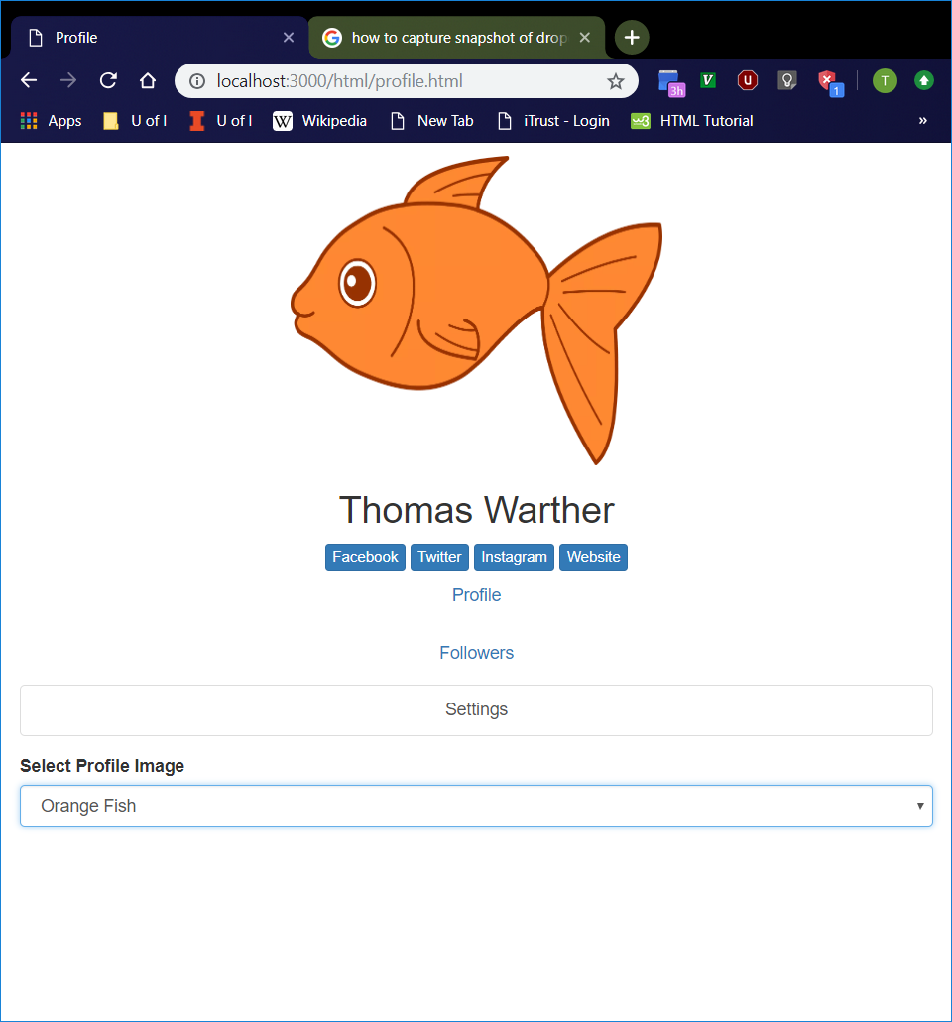
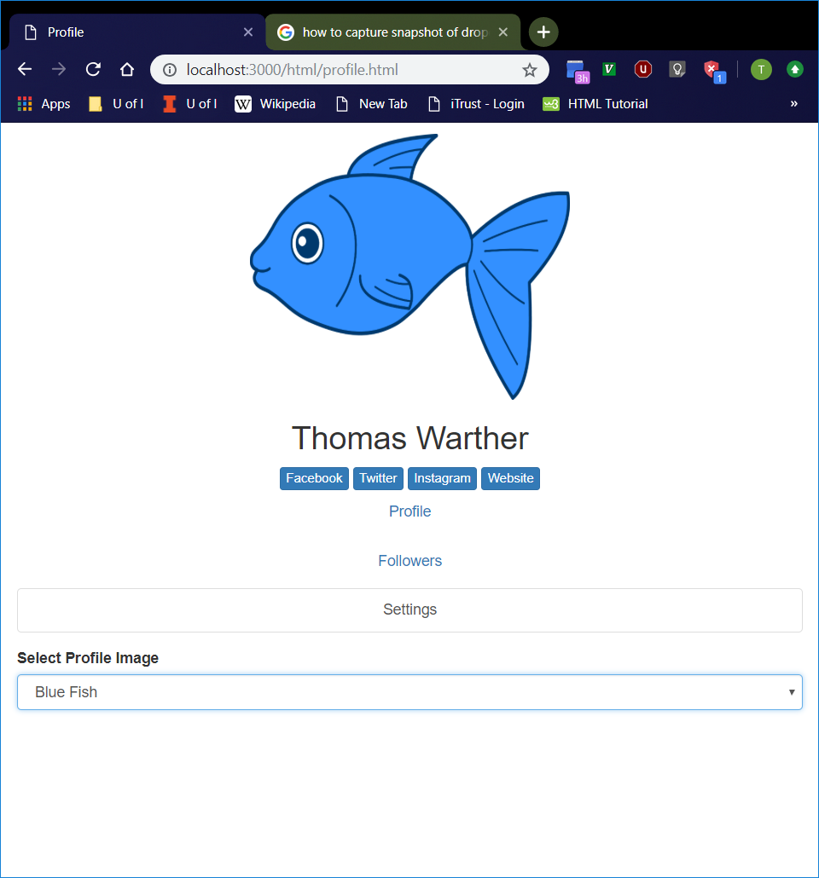
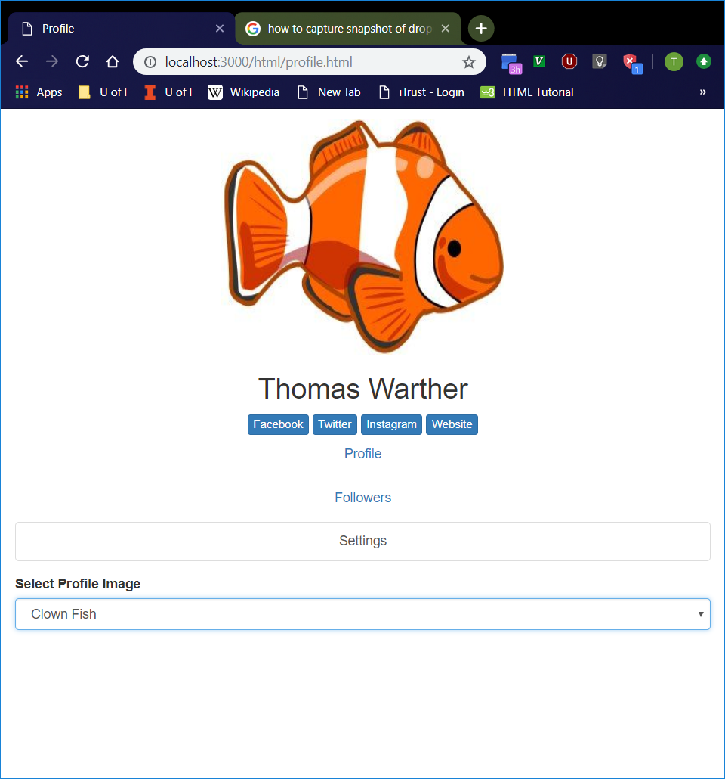
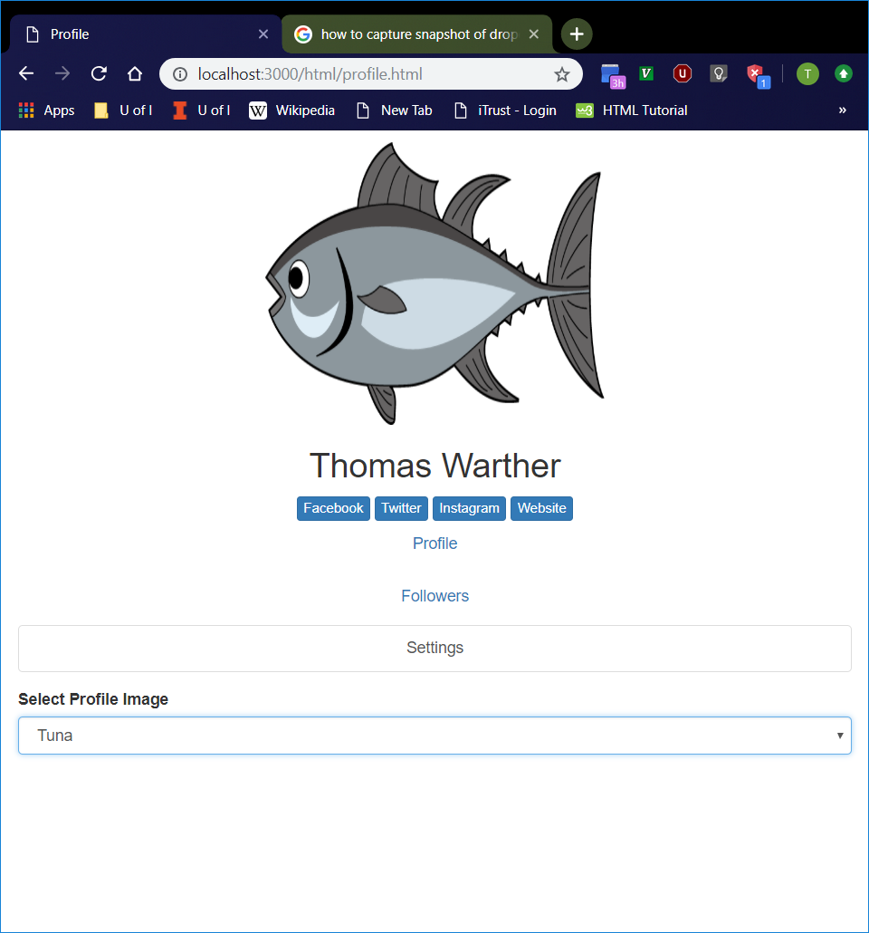
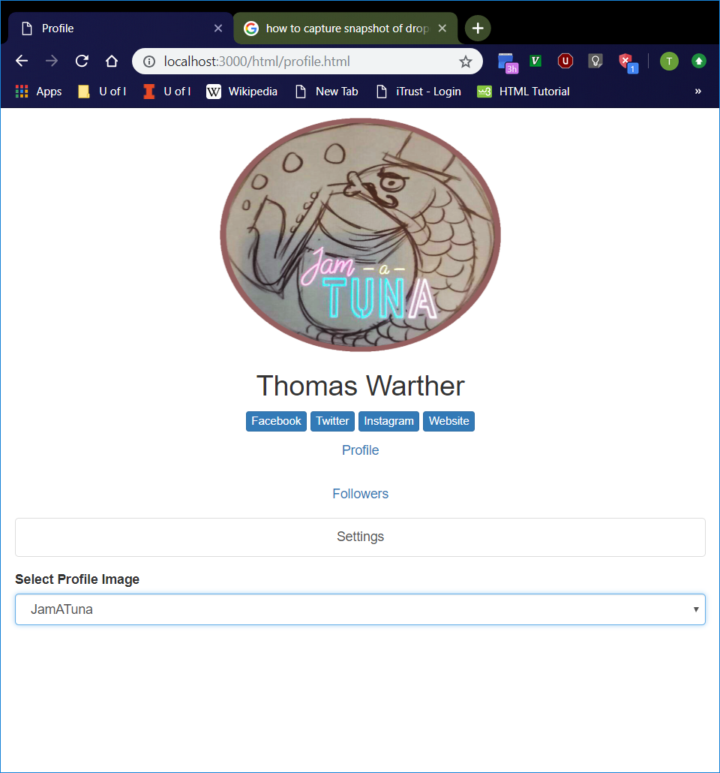
Available Profile Pictures
Select every option in the “Settings” tab dropdown menu, one-by-one except “Other”.
Profile picture should be updated with the appropriate picture.
Orange Fish
Blue Fish
Clown Fish
Tuna
JamATuna

Slide 8
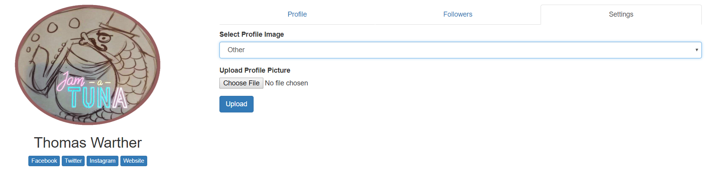
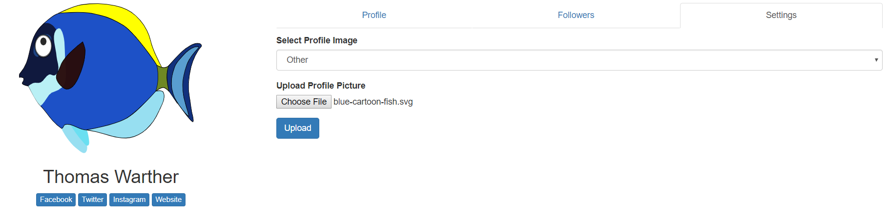
Uploading Profile Pictures
“Upload Profile Picture” Option
Select “Other” from dropdown menu in “Settings tab.
File upload button with “Upload Profile Picture” label and “Upload” button should now appear, and they should disappear after selecting a different option from dropdown menu.
File upload button should bring up File Explorer or similar file upload window
Selecting a file should immediately update the profile picture with the image file.
“Upload” button to be implemented in the future
After Selecting Image File

Slide 9
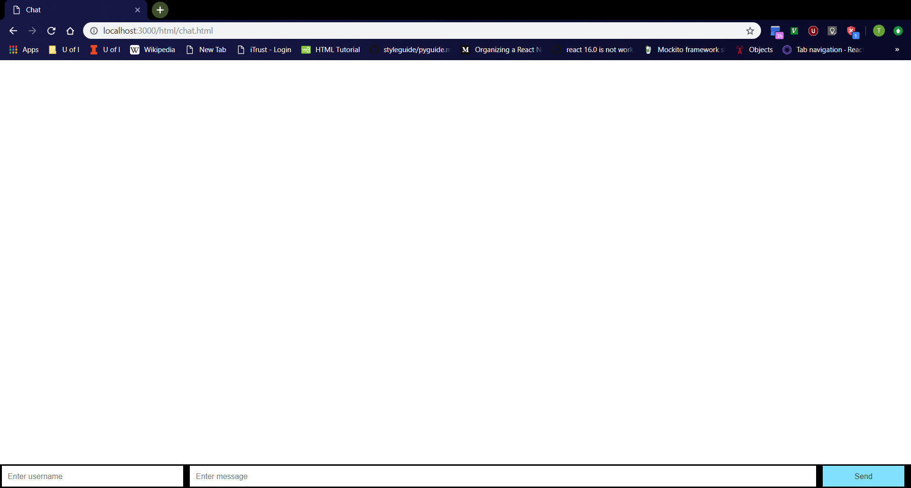
Chat Page
Click “Chat” button on home page.
Should navigate to http://localhost:3000/html/chat.html
From left to right at the bottom of the page, should see username box, message box, then “Send” button
Username box should be empty with “Enter username” placeholder.
Message box should be empty with “Enter message” placeholder.

Slide 10
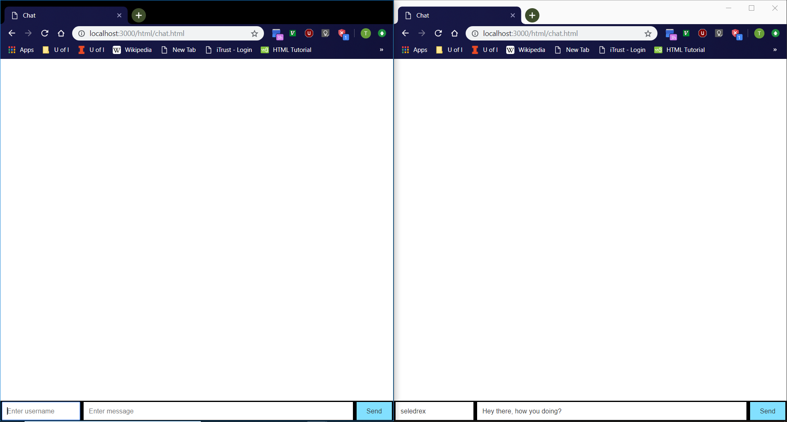
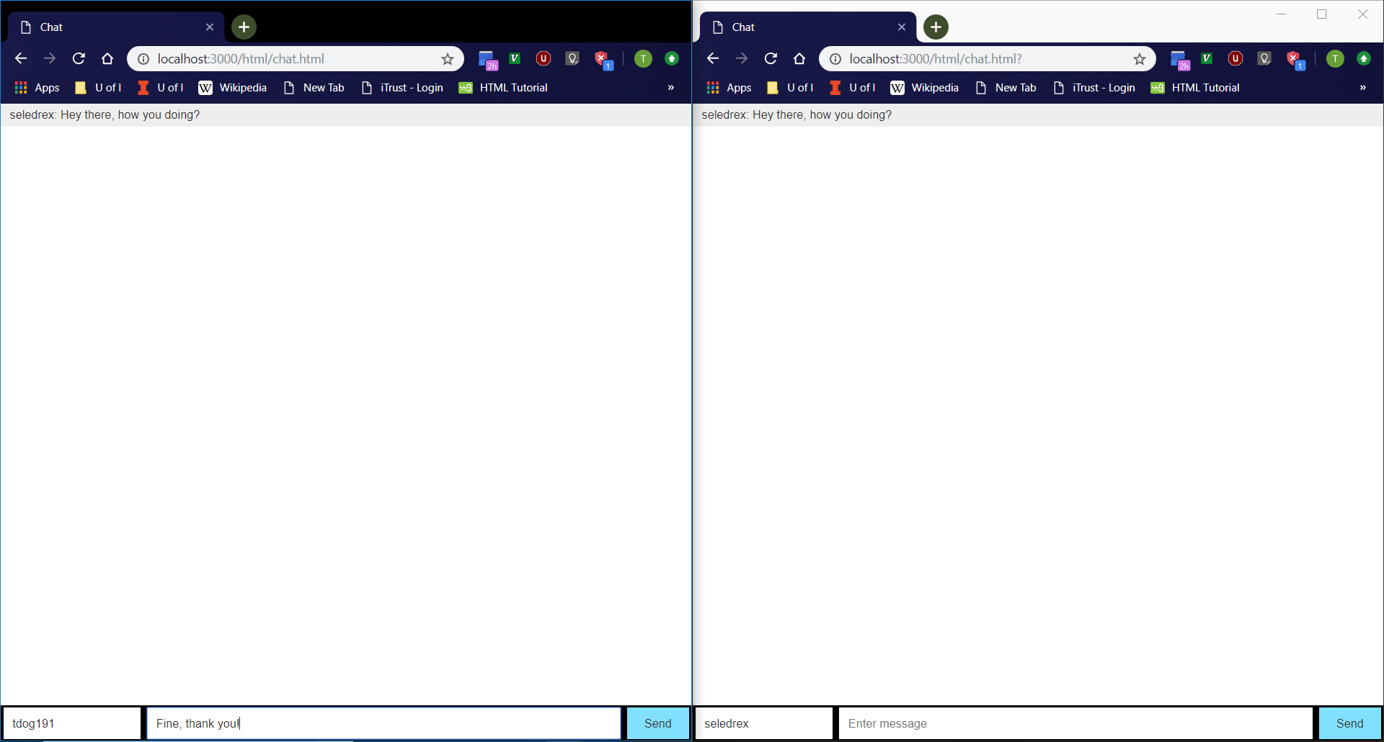

Chat Page Cont.
Open chat page in two browser tabs.
Type username and messages into either tab and hit ‘Enter’.
Messages should show on both tabs.
Every sent message should be of the form “<username>: <message>”.
Every odd-numbered message should have a gray background.
Message box should become empty after a message is sent.

Slide 11
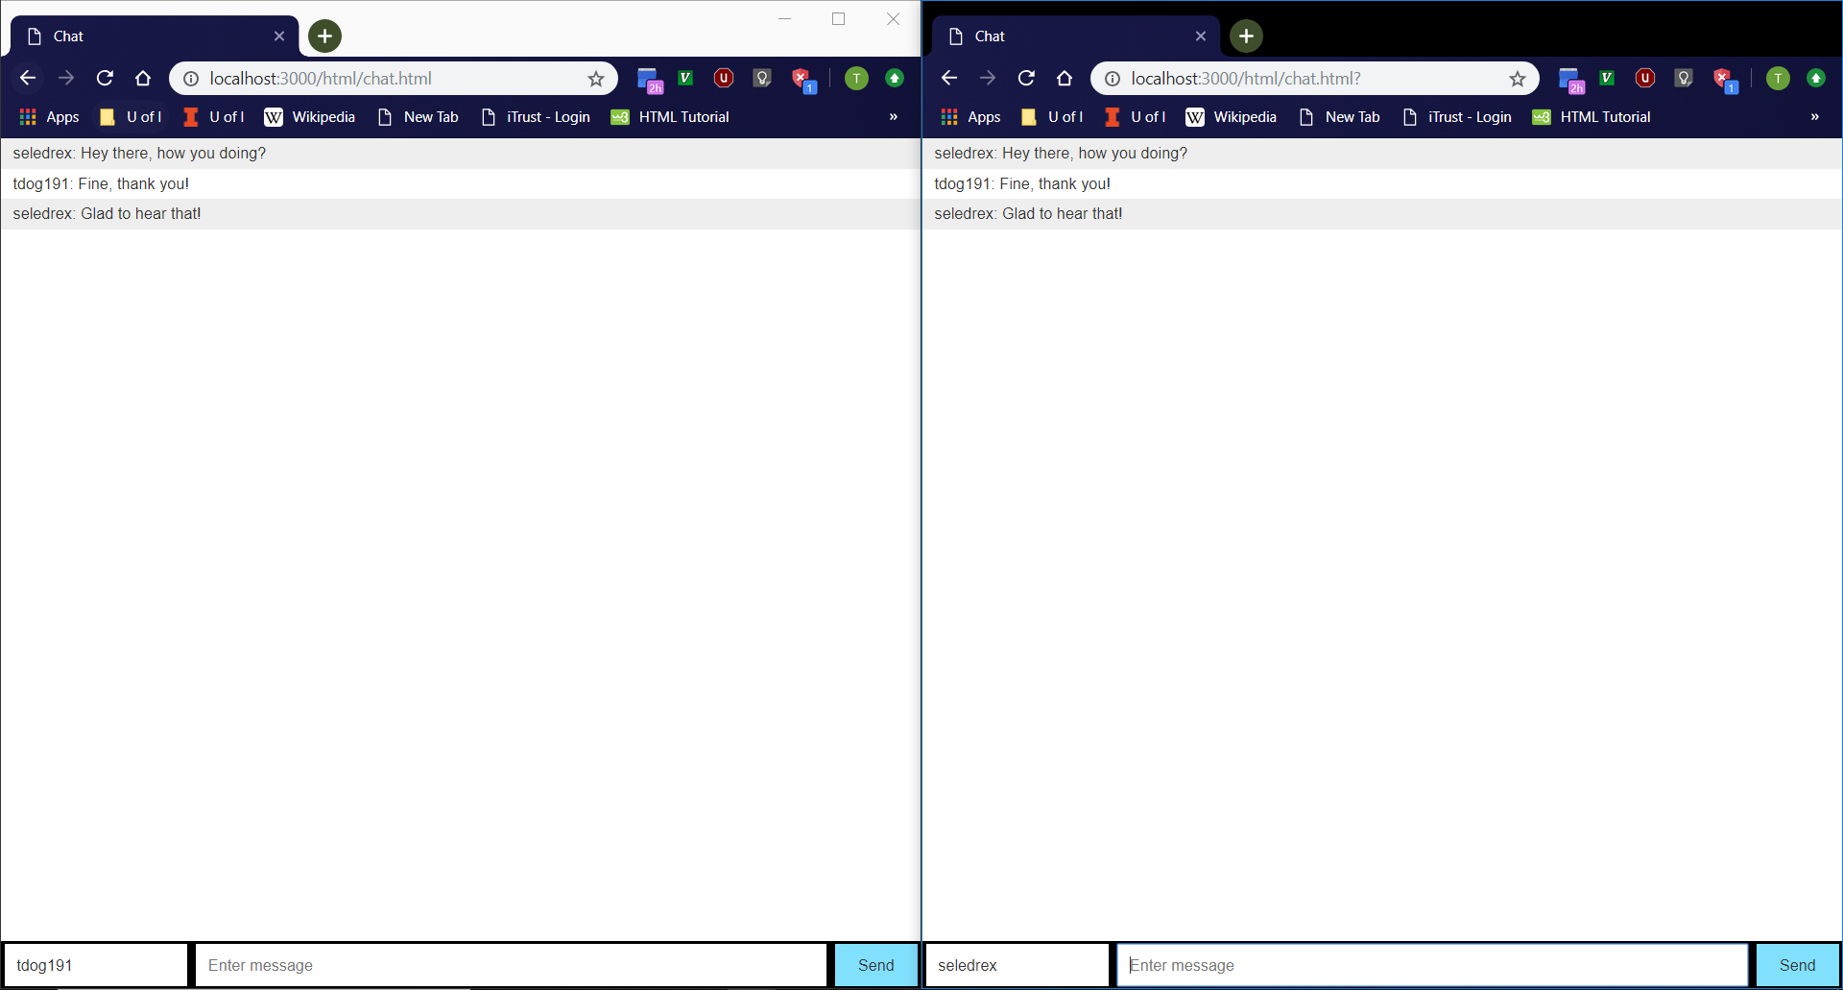
Chat Page Example
Step 1
Step 2
Step 4
Step 3

Slide 12
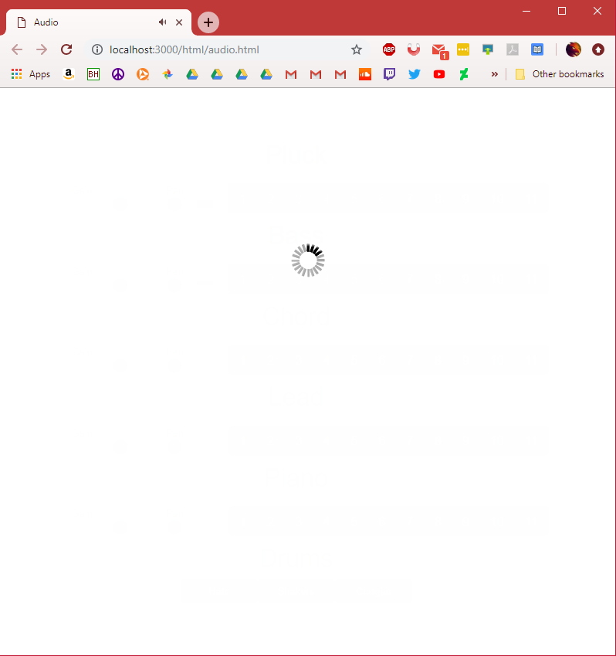
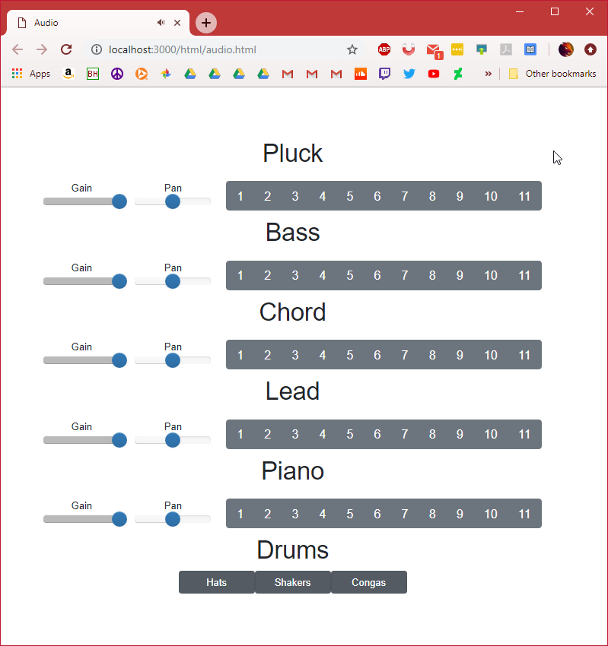
Audio Page
Navigate to http://localhost:3000/html/audio.html
Loading screen should appear first
Should see title and buttons centered in screen after
Drum beat should start

Slide 13
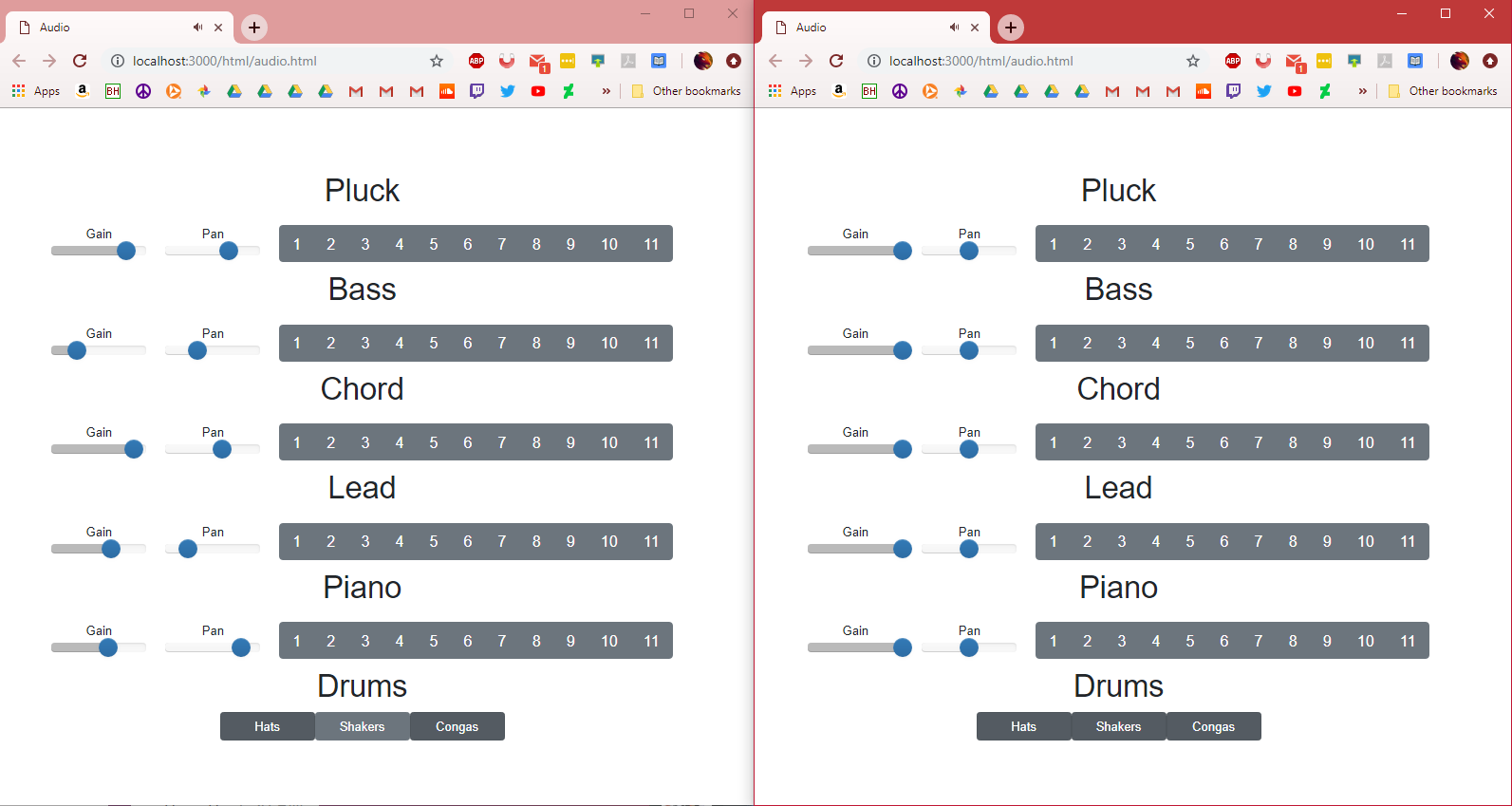
Audio Page
Continued
Pressing a button on either tab will play an audio file
Audio files should be played on both tabs
Sound should be in sync no matter how irregular clicks are made
Gain and pan sliders should work

Slide 14
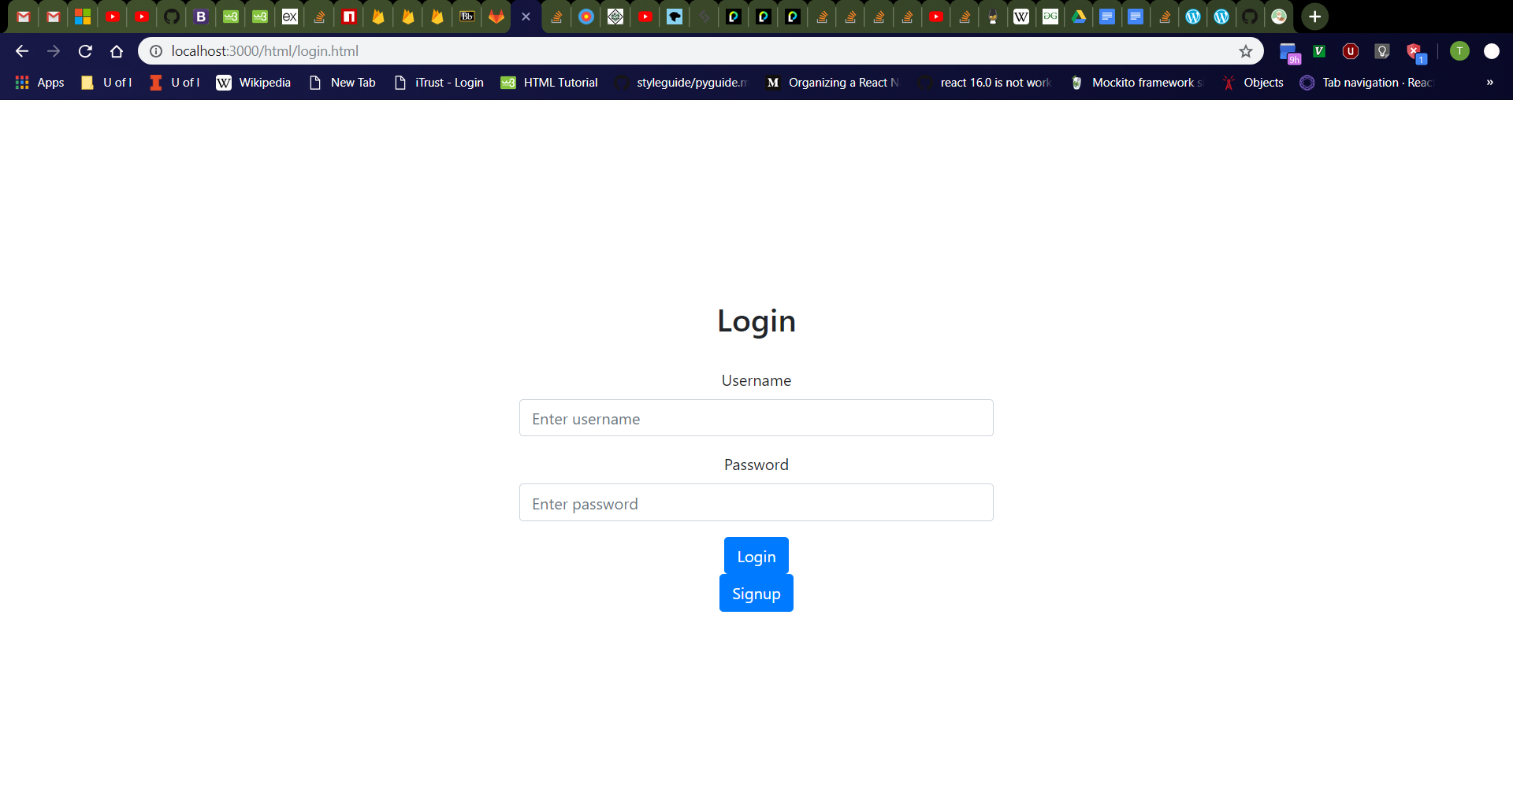
Login Page
Click “Login” button on home page.
Should navigate to http://localhost:3000/html/login.html
From top to bottom, should see “Login” header, username box with label, password box with label, “Login” button, then “Signup” button
Username box should be empty with “Enter username” placeholder.
Password box should be empty with “Enter password” placeholder.

Slide 15
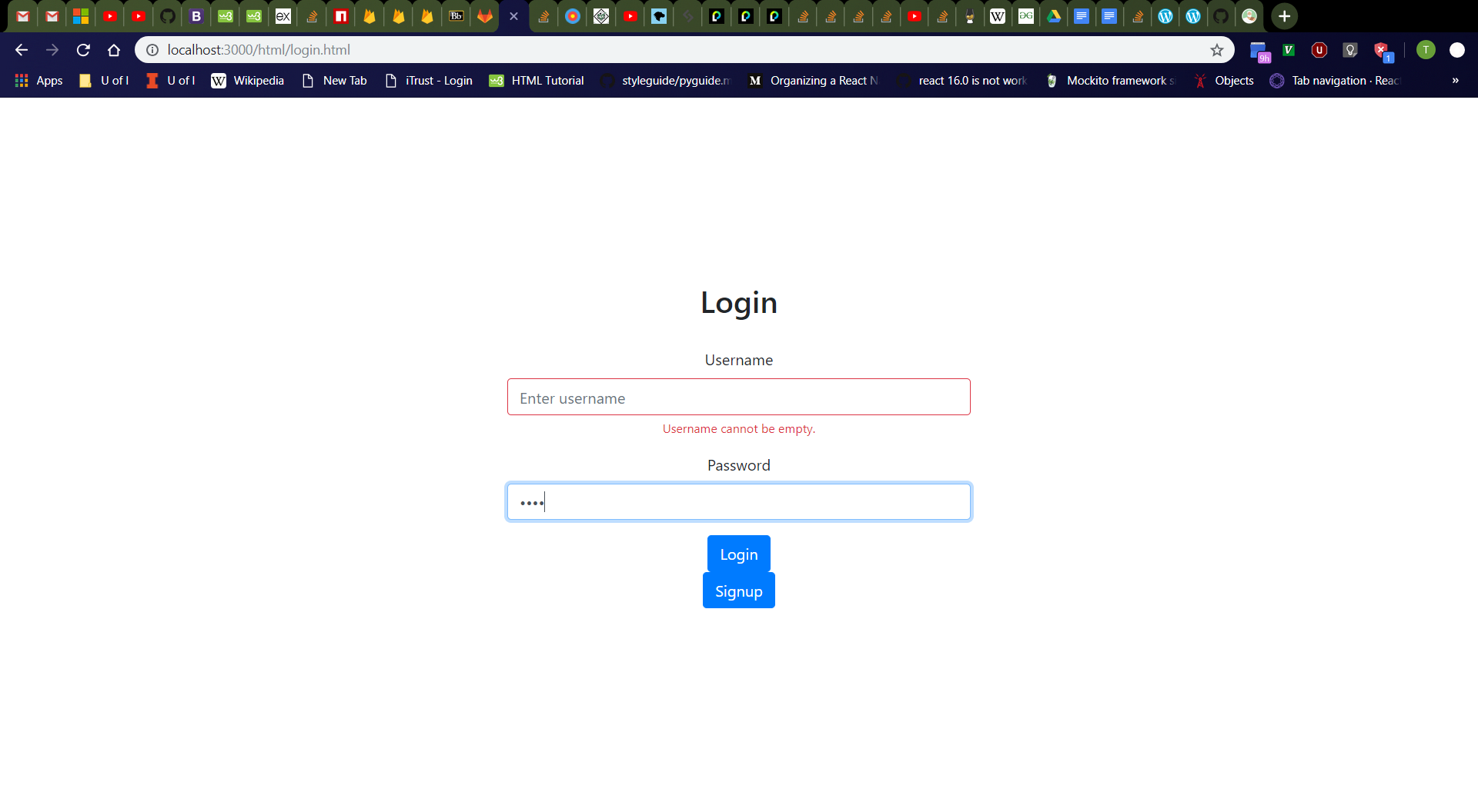
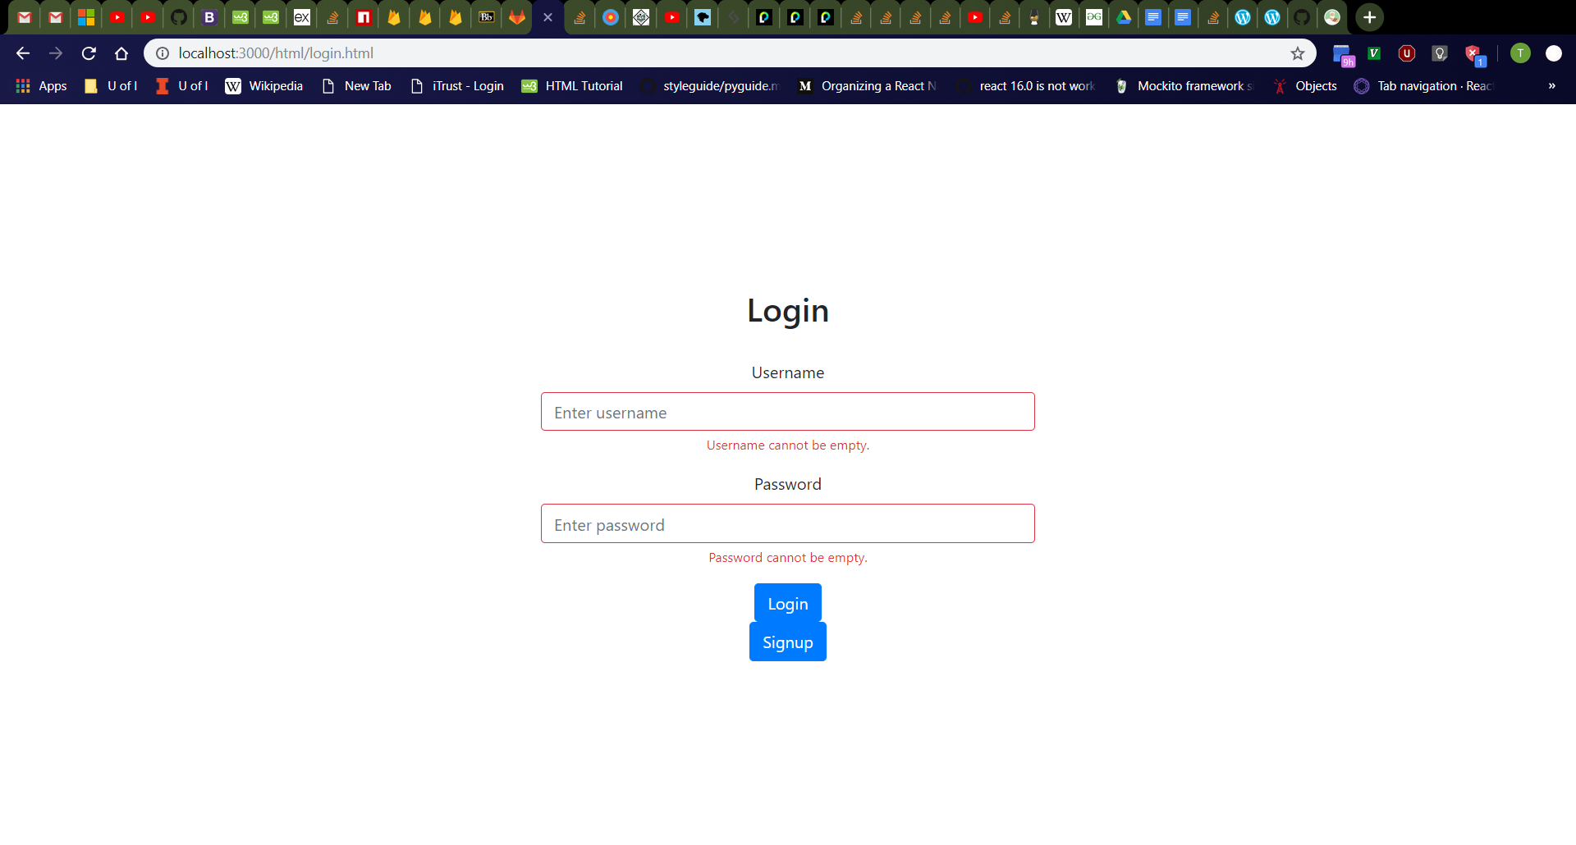
Login Page Error Messages
Click username box, then password box, then click away.
Should see username and password boxes turn red with red “Username cannot be empty.” and “Password cannot be empty.” messages respectively
Refresh the page then click the “Login” button
Should see red error messages again
Validation checks for empty username and password should always occur as user releases keyboard keys, the boxes lose focus, and when the “Login” button is clicked.
Empty Username
Empty Username and Password

Slide 16
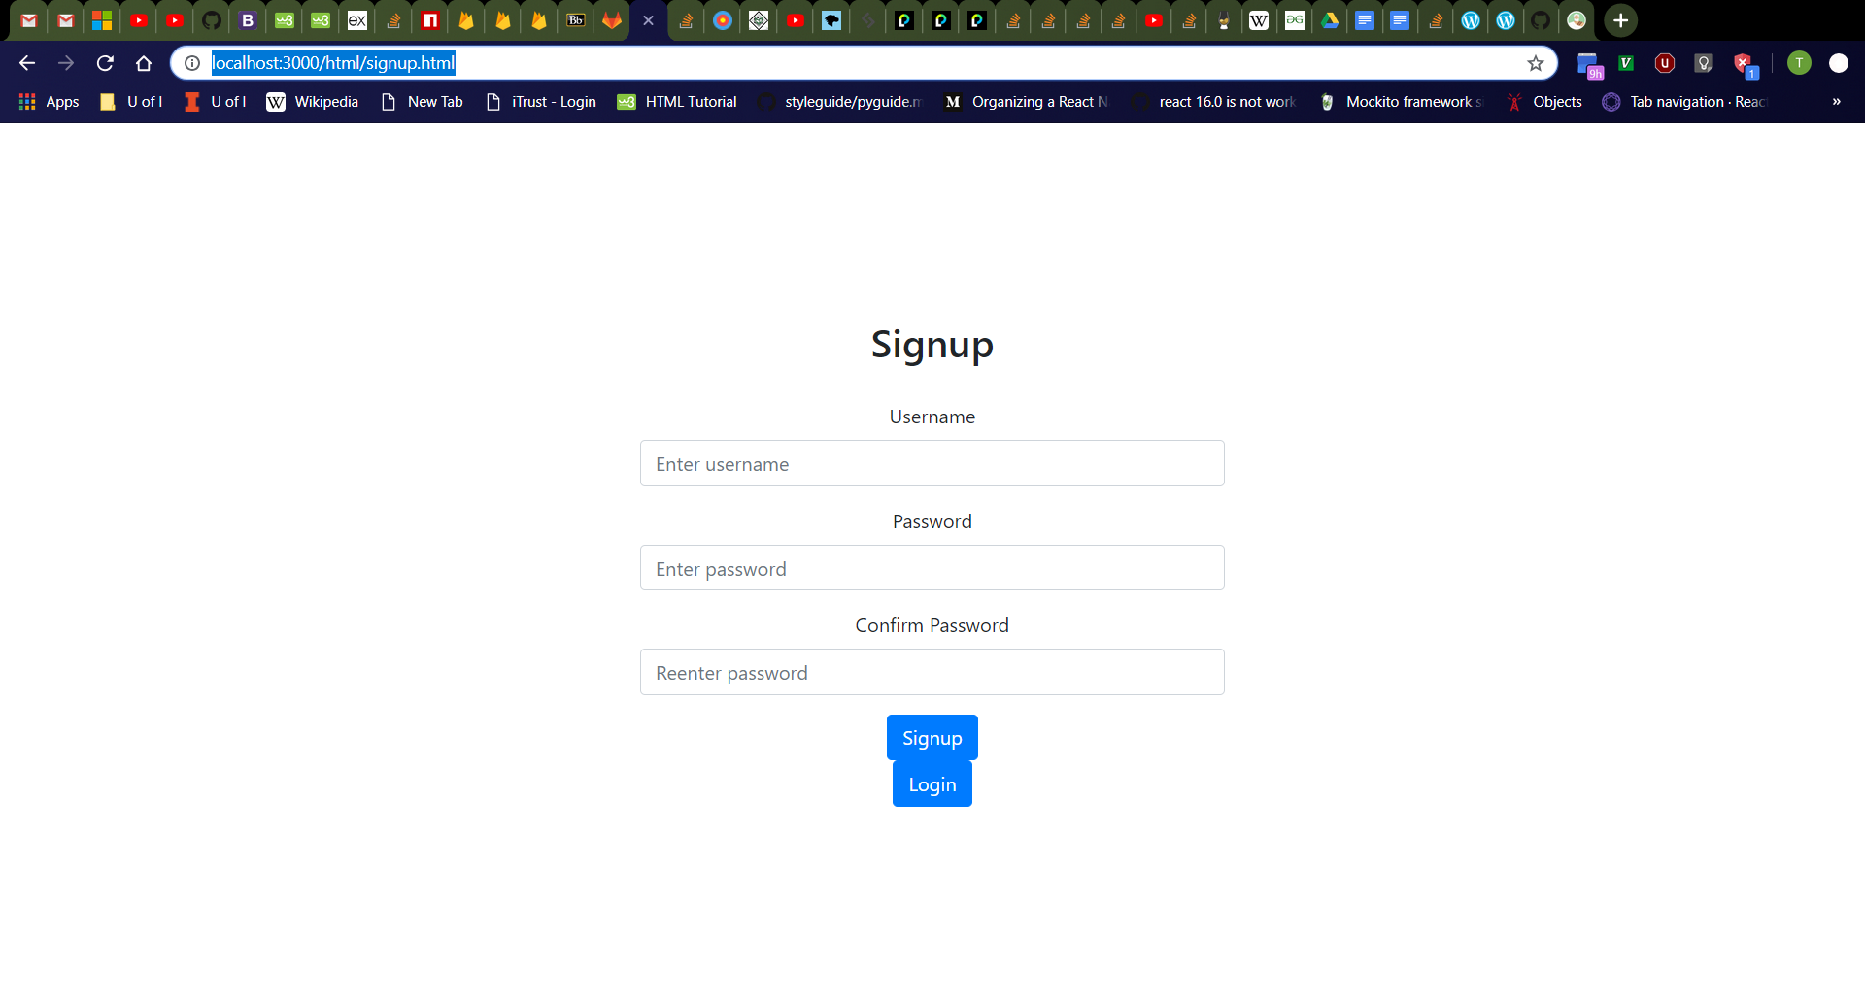
Signup Page
Click “Signup” button on login page.
Should navigate to http://localhost:3000/html/signup.html
From top to bottom, should see “Signup” header, username box with label, password box with label, “Confirm Password” box with label, “Signup” button, then “Login” button
Username box should be empty with “Enter username” placeholder.
Password box should be empty with “Enter password” placeholder.
“Confirm Password” box should be empty with “Reenter password” placeholder.

Slide 17
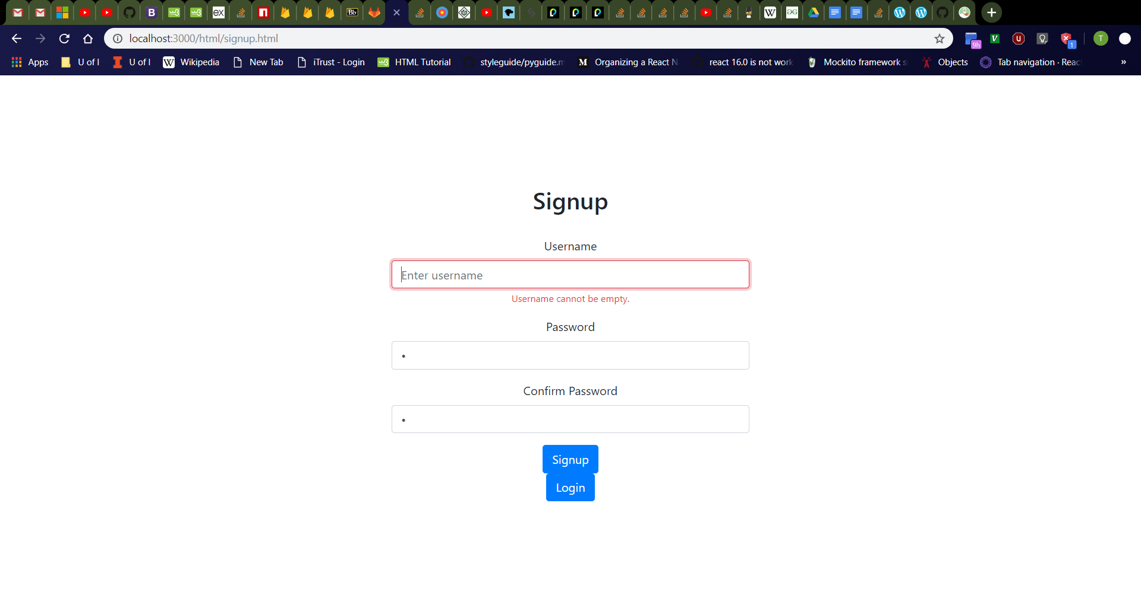
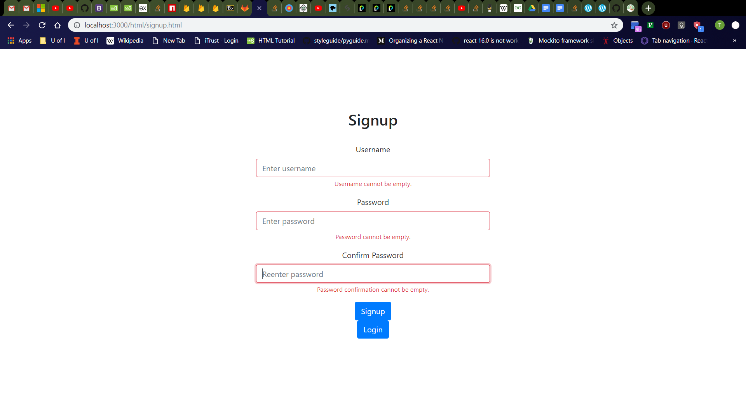
Signup Page Error Messages
Click username box, then password box, then password confirmation box, then click away.
Should see username, password, and password confirmation boxes turn red with red “Username cannot be empty.”, “Password cannot be empty.”, and “Password confirmation cannot be empty.” messages respectively
Refresh the page then click the “Signup” button
Should see red error messages again
Validation checks for empty username, password, and password confirmation should always occur as user releases keyboard keys, the boxes lose focus, and when the “Signup” button is clicked.
Empty Username and Identical Password and Password Confirmation
All boxes empty

Slide 18
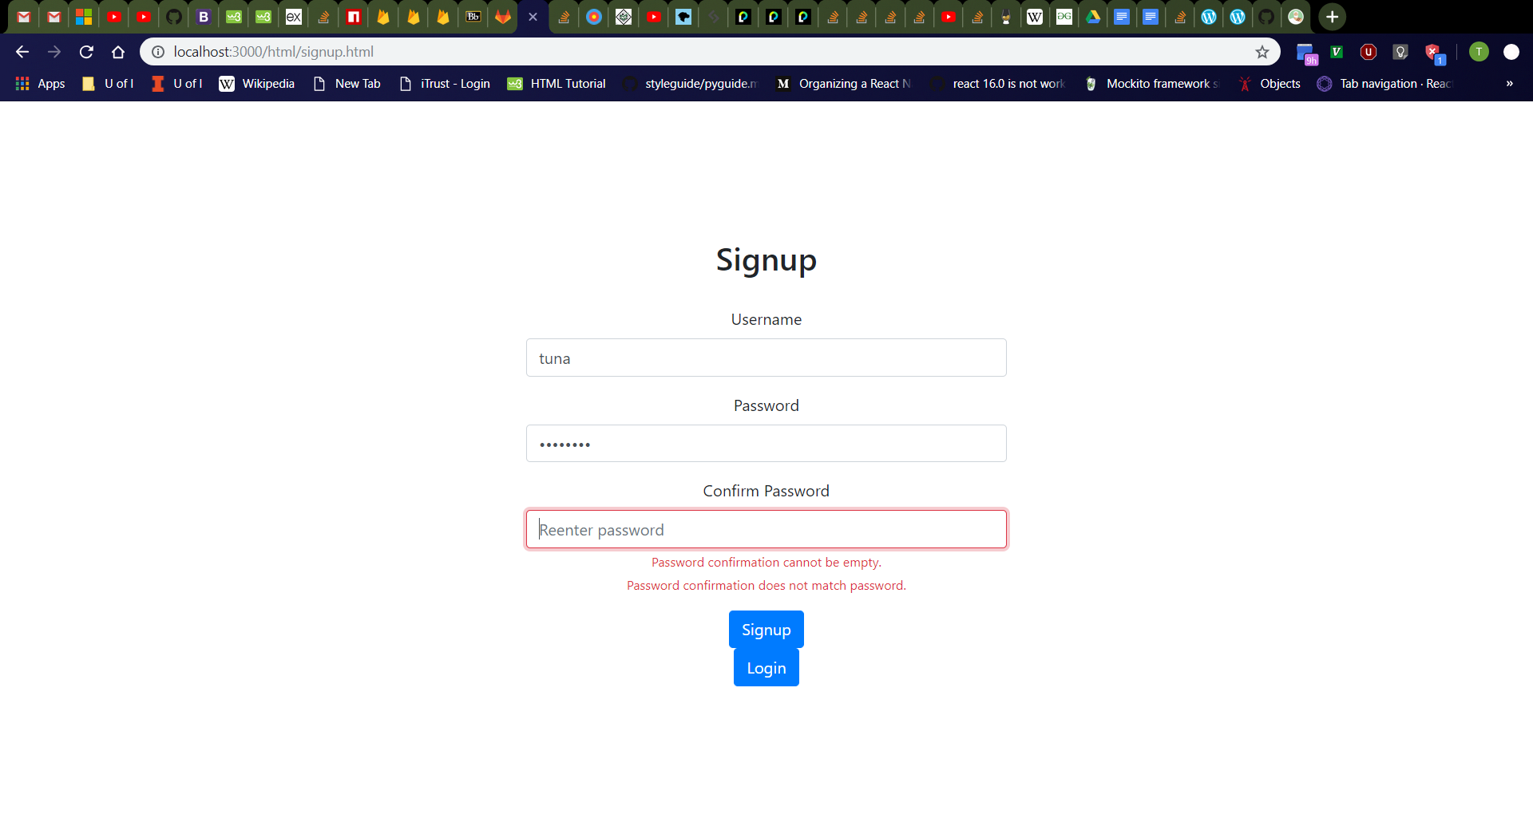

Signup Page Error Messages Cont.
Type “tuna” in username, “password” in password, and click password confirmation box.
Should see password confirmation box turn red with red “Password confirmation cannot be empty.” and “Password confirmation does not match password.” messages below
Type “password2” in password confirmation box
Should still see red “Password confirmation does not match password.” message
Password and Empty Password Confirmation
Unidentical Passwords

Slide 19
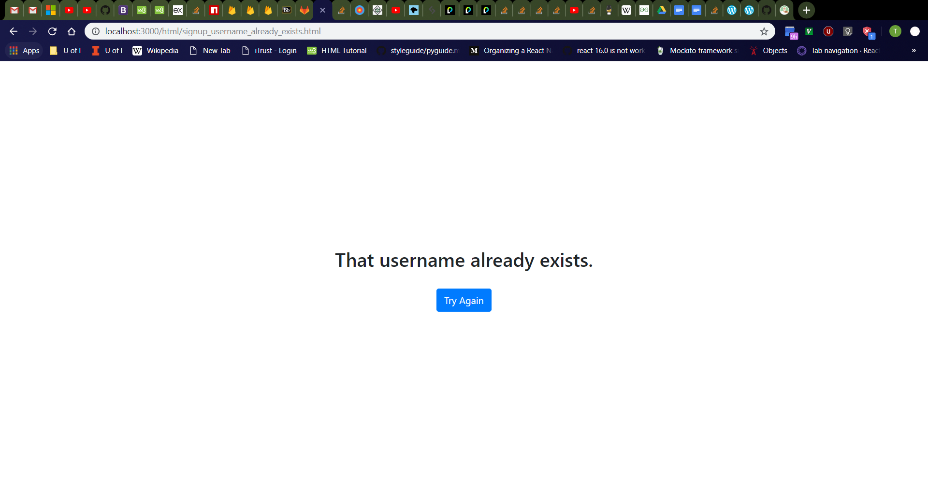
Signup Page (Username Already Exists)
Enter the following values in the signup page:
Username: “tdog191” (or other existing username in database)
Password: “password”
Confirm Password: “password”
Should see new page with message “That username already exists.” and “Try Again” button.

Slide 20
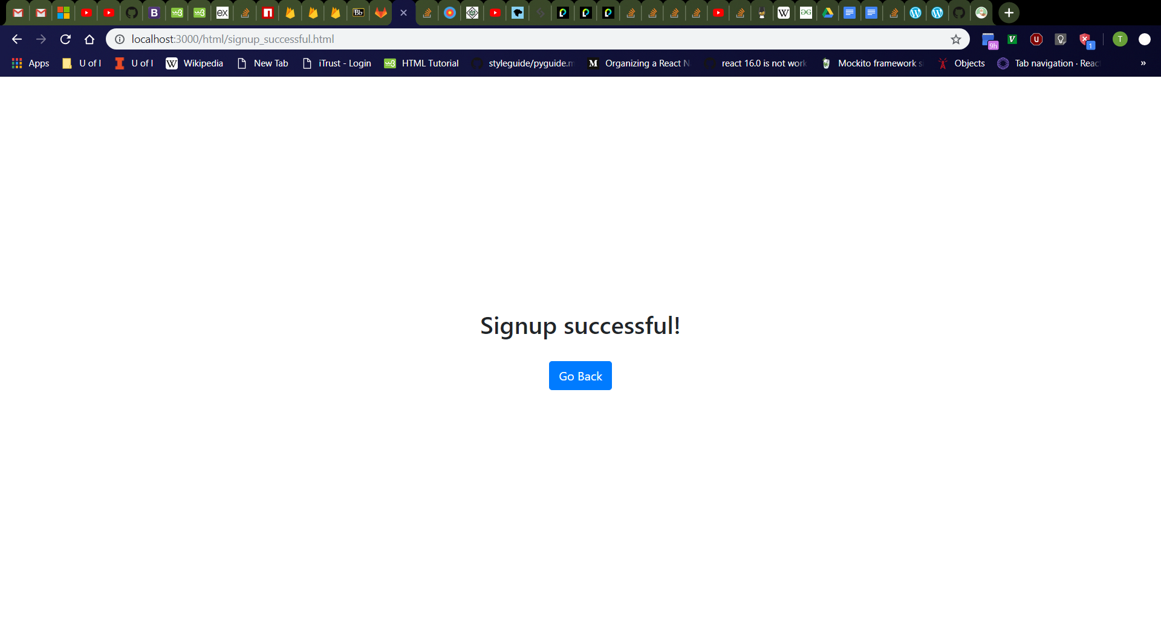
Signup Page (Success)
Click “Try Again” button
Should navigate to http://localhost:3000/html/signup.html
Enter the following values in the signup page:
Username: “tuna” (or other nonexistent username in database)
Password: “password”
Confirm Password: “password”
Should see new page with message “Signup successful!” and “Go Back” button.

Slide 21
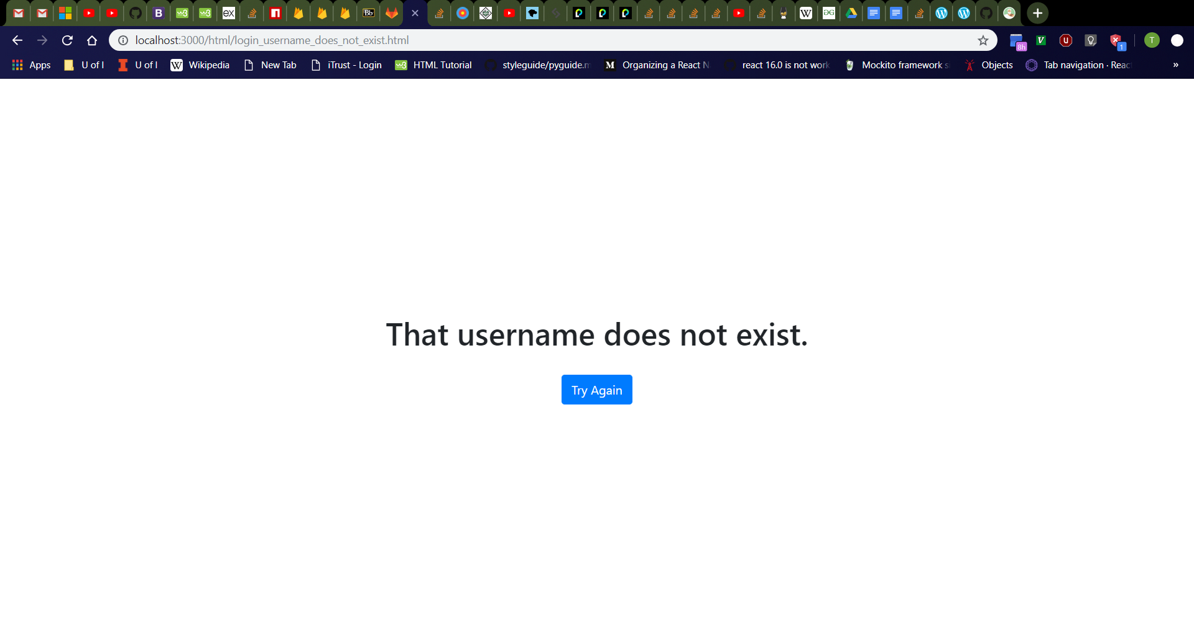
Login Page (Username Does Not Exist)
Click “Go Back” button then “Login” button
Should navigate to http://localhost:3000/html/signup.html then http://localhost:3000/html/login.html
Enter the following values in the login page:
Username: “tuna2” (or other nonexistent username in database)
Password: “password”
Should see new page with message “That username does not exist.” and “Try Again” button.

Slide 22

Login Page (Incorrect Password)
Click “Try Again” button
Should navigate to http://localhost:3000/html/login.html
Enter the following values in the login page:
Username: “tuna” (or other existing username in database)
Password: “password2” (or other incorrect password)
Should see new page with message “That password is incorrect.” and “Try Again” button.

Slide 23

Login Page (Success)
Click “Try Again” button
Should navigate to http://localhost:3000/html/login.html
Enter the following values in the login page:
Username: “tuna” (or other existing username in database)
Password: “password” (or which password is correct)
Should see new page with message “Login successful!” and “Go Back” button.

Slide 24
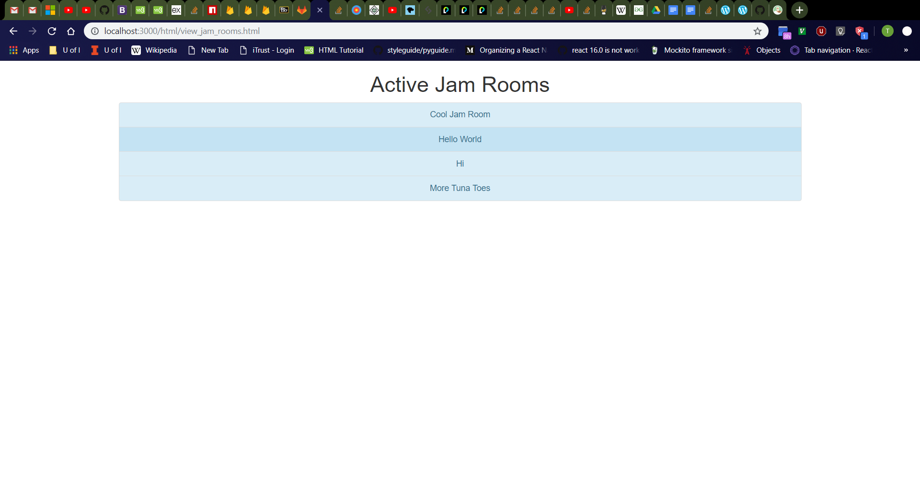
Jam Rooms Page
Click “Jam Rooms” button on home page.
Should navigate to http://localhost:3000/html/view_jam_rooms.html
From top to bottom, should see “Active Jam Rooms” header and list of all existing jam rooms, each with a light-blue background
For now, each jam room entry should navigate to user profile page when clicked (to be updated in the future)

Slide 25

Create Jam Room Page
Click “Create Jam Room” button on home page.
Should navigate to http://localhost:3000/html/create_jam_room.html
From top to bottom, should see “Create Jam Room” header, jam room name box with label, owner username box with label, then “Create” button
Jam room name box should be empty with “Enter name” placeholder.
Owner username box should be empty with “Enter owner username” placeholder.

Slide 26

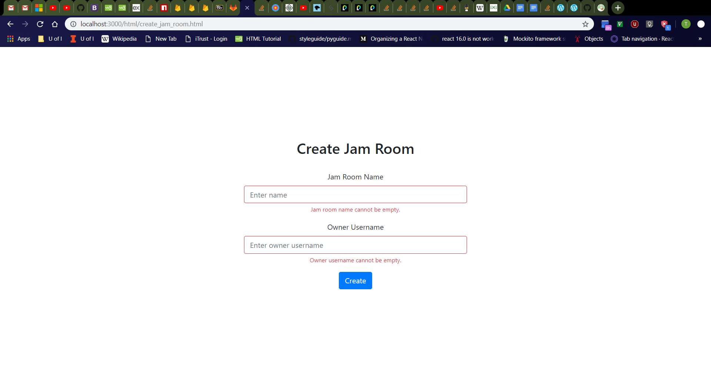
Create Jam Room Page Error Messages
Click jam room name box, then owner username box, then click away.
Should see jam room name and owner username boxes turn red with red “Jam room name cannot be empty.” and “Owner username cannot be empty.” messages respectively
Refresh the page then click the “Create” button
Should see red error messages again
Validation checks for empty jam room name and owner username boxes should always occur as user releases keyboard keys, the boxes lose focus, and when the “Create” button is clicked.
Empty Jam Room Name
All boxes empty

Slide 27

Create Jam Room Page (Jam Room Already Exists)
Enter the following values in the jam room creation page:
Jam Room Name: “More Tuna Toes” (or other existing jam room in database)
Owner Username: “tdog191”
Should see new page with message “That jam room already exists.” and “Try Again” button.

Slide 28

Create Jam Room Page (Owner Username Does Not Exist)
Click “Try Again” button
Should navigate to http://localhost:3000/html/create_jam_room.html
Enter the following values in the jam room creation page:
Jam Room Name: “Dancing Tuna Feet” (or other nonexistent jam room in database)
Owner Username: “salt” (or other nonexistent user in database)
Should see new page with message “That owner username does not exist.” and “Try Again” button.

Slide 29
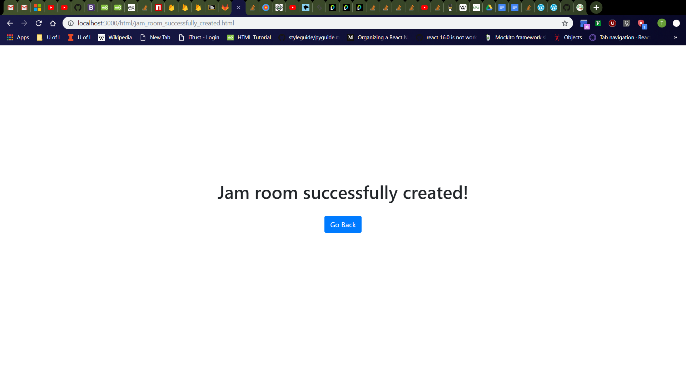
Create Jam Room Page (Success)
Click “Try Again” button
Should navigate to http://localhost:3000/html/create_jam_room.html
Enter the following values in the jam room creation page:
Jam Room Name: “Dancing Tuna Feet” (or other nonexistent jam room in database)
Owner Username: “tdog191” (or other existing user in database)
Should see new page with message “Jam room successfully created!” and “Go Back” button.

Slide 30
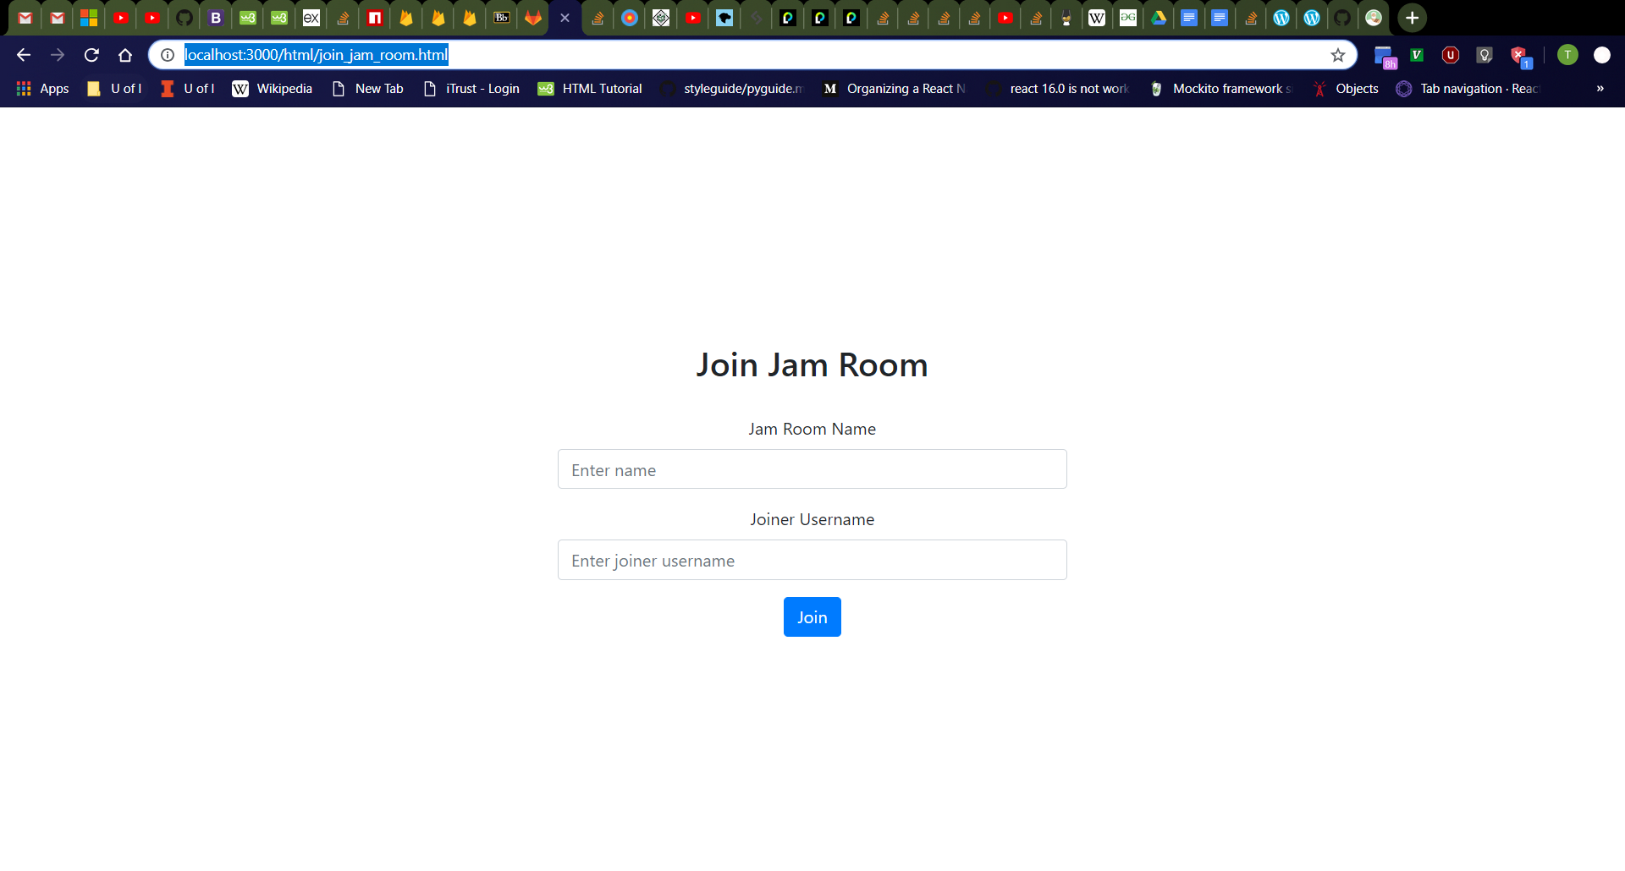
Join Jam Room Page
Click “Join Jam Room” button on home page.
Should navigate to http://localhost:3000/html/join_jam_room.html
From top to bottom, should see “Join Jam Room” header, jam room name box with label, joiner username box with label, then “Join” button
Jam room name box should be empty with “Enter name” placeholder.
Joiner username box should be empty with “Enter joiner username” placeholder.

Slide 31

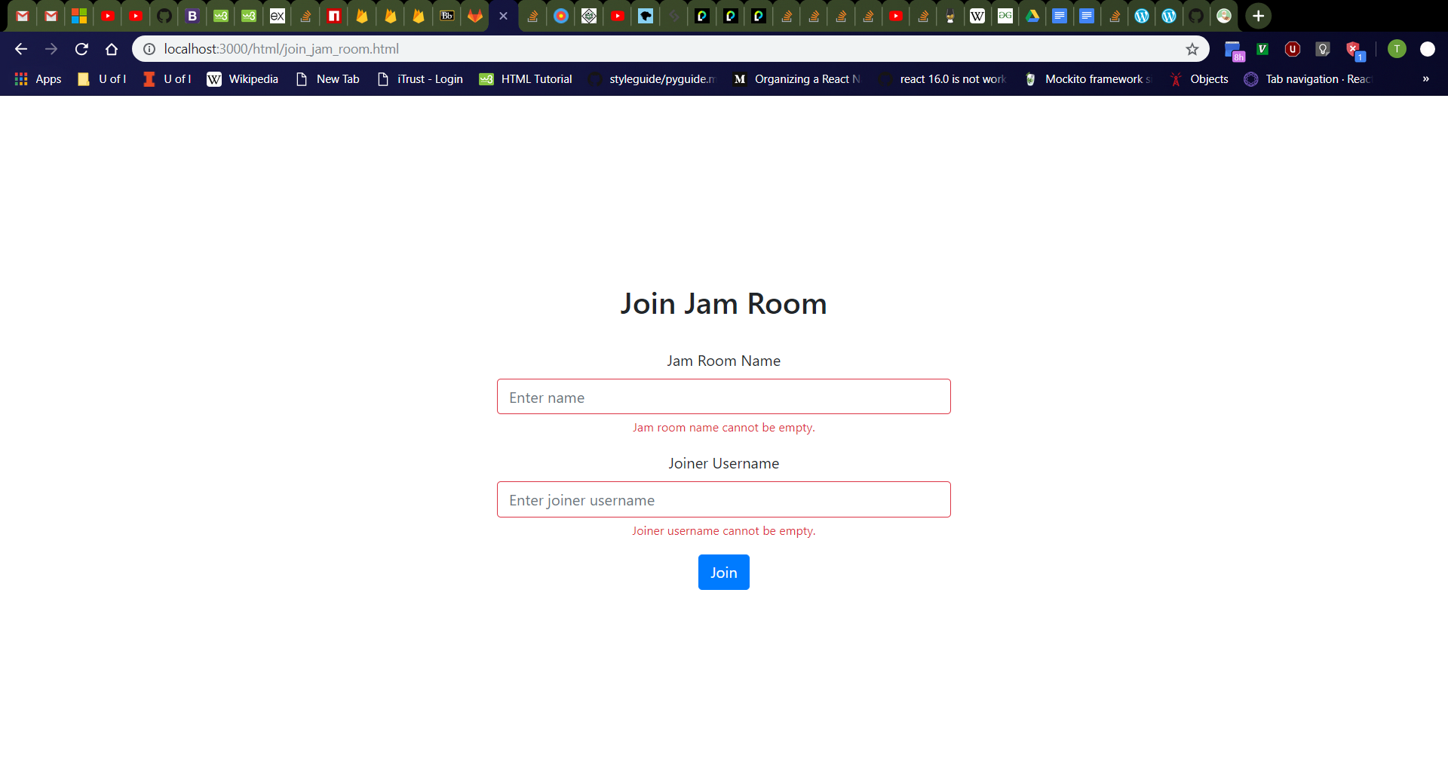
Join Jam Room Page Error Messages
Click jam room name box, then joiner username box, then click away.
Should see jam room name and joiner username boxes turn red with red “Jam room name cannot be empty.” and “Joiner username cannot be empty.” messages respectively
Refresh the page then click the “Join” button
Should see red error messages again
Validation checks for empty jam room name and joiner username boxes should always occur as user releases keyboard keys, the boxes lose focus, and when the “Join” button is clicked.
Empty Jam Room Name
All boxes empty

Slide 32

Join Jam Room Page (Jam Room Does Not Exist)
Enter the following values in the jam room joining page:
Jam Room Name: “Singing Tuna” (or other nonexistent jam room in database)
Joiner Username: “tdog191”
Should see new page with message “That jam room does not exist.” and “Try Again” button.

Slide 33

Join Jam Room Page (Joiner Username Does Not Exist)
Click “Try Again” button
Should navigate to http://localhost:3000/html/join_jam_room.html
Enter the following values in the jam room joining page:
Jam Room Name: “Dancing Tuna Feet” (or other existing jam room in database)
Joiner Username: “salt” (or other nonexistent user in database)
Should see new page with message “That joiner username does not exist.” and “Try Again” button.

Slide 34

Join Jam Room Page (Success)
Click “Try Again” button
Should navigate to http://localhost:3000/html/join_jam_room.html
Enter the following values in the jam room joining page:
Jam Room Name: “Dancing Tuna Feet” (or other existing jam room in database)
Joiner Username: “tdog191” (or other existing user in database)
Should see new page with message “Successfully joined jam room!” and “Go Back” button.

Slide 35
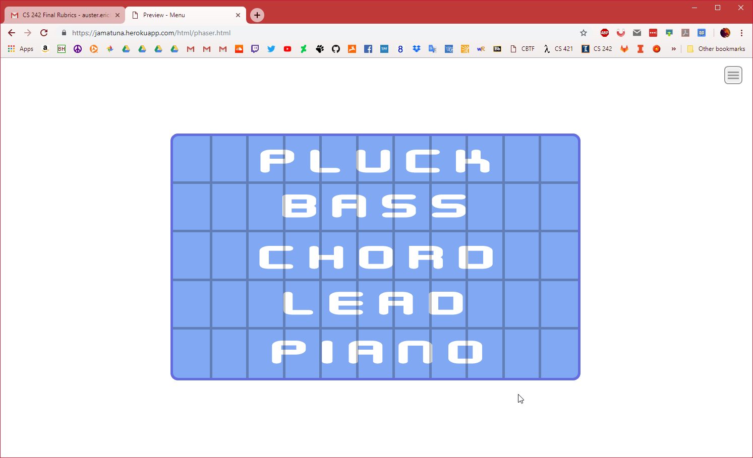
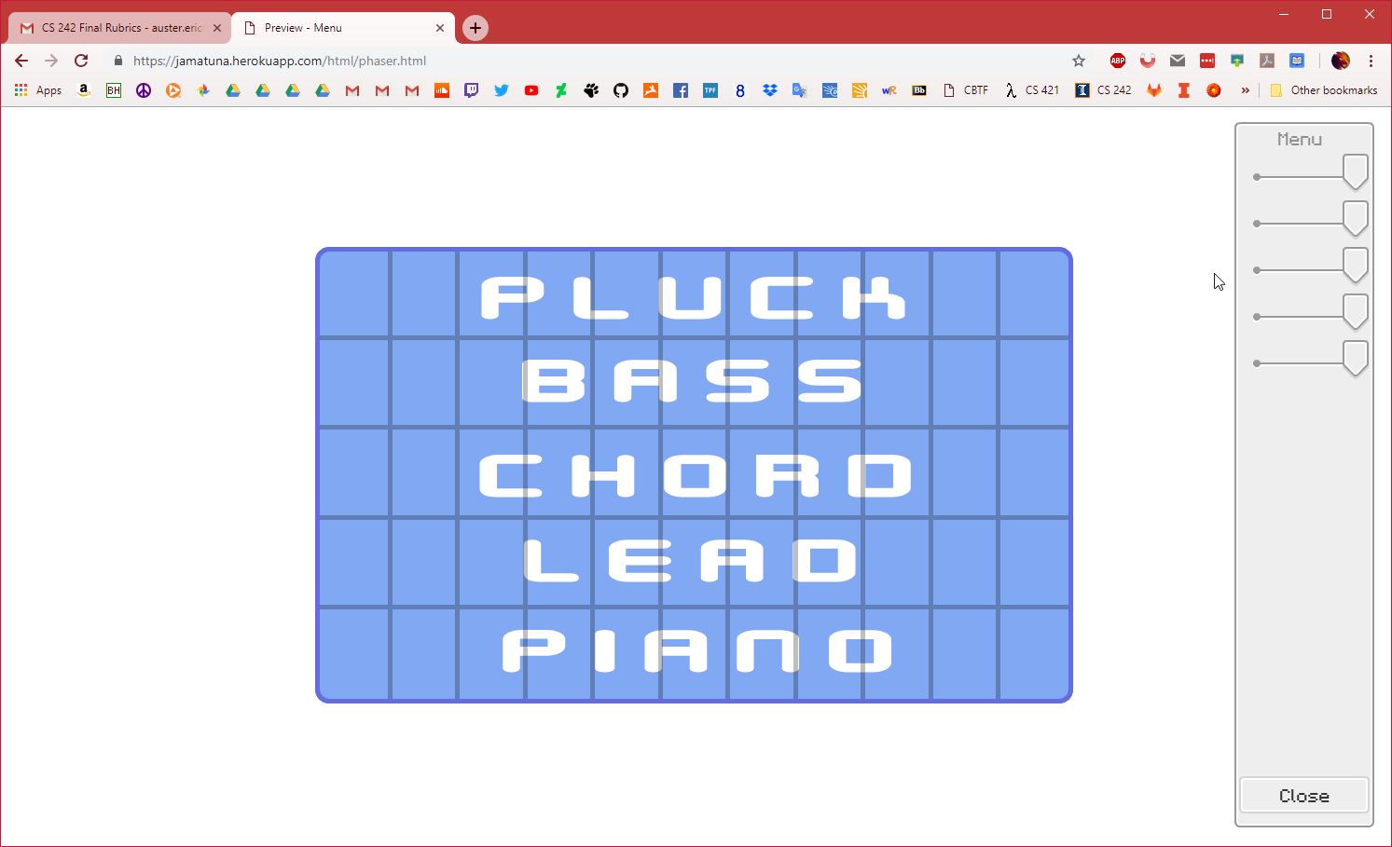
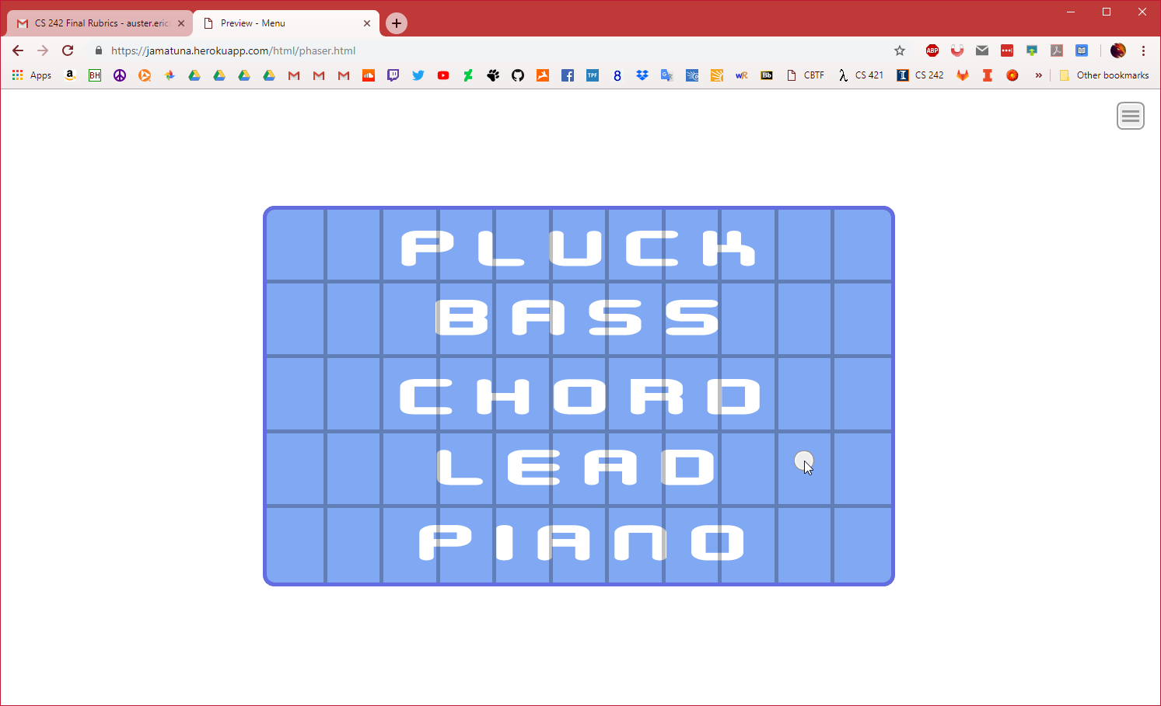
Phaser
Phaser engine shows on page load
Side menu is toggleable
Clicking the instrument panel shows the cursor

